Slide 1




























IoT and t3leSense™:
Advanced IoT Platform
Any sensor, any scale. Your data, your rules.
James Patke
VP of Sales and Business Development
September 26, 2024

Slide 2
AGENDA
Objectives:
Demonstrating how IoT transforms operations across industries.
Addressing challenges like physical security and aging infrastructure.
IoT Across Industries
Key IoT Applications Across Sectors
IoT Addressing Aging Infrastructure
IoT Physical Security
IoT Benefits Summary Across Industries
t3leSense™ Platform
Sample Use Cases

Slide 3
IoT Across Industries
What is IoT and how does it work?
  Residential IoT model.
  Industrial/Enterprise markets such as utilities, precision agriculture, and health care.
  Sensor monitoring of critical infrastructure.
  Machine to machine, wired (ethernet), wireless air interface LoRa (long range), Narrowband IoT, 4G/5G including CBRS, CAT-M, Bluetooth, Zigbee, WiFi.
  What are the Key components?
  Sensors, Connectivity, Data Analytics, and Automation.
  Devices for actions based on sensor output.
  Why does it matter?
  Real-time monitoring, predictive maintenance, and operational cost reduction.
  Improves operational efficiency.
  Maximizes asset investments.
  Enhances security and safety.

Slide 4
Sample IoT Applications Across Sectors
  Energy & Environment
  Smart meters, energy efficiency, and sustainability.
  Industrial IoT across sectors.
  Monitoring equipment, organizing production, and reducing downtime.
  Smart Cities
  Public safety, smart lighting, and traffic management.
  Health Care
  Wearable devices, patient monitoring, and hospital asset tracking.
  Retail & Supply Chain
  Inventory management, logistics, and customer behavior.

Slide 5
IoT Addressing Aging Infrastructure
  Real Time Detection Optimizing Replacement Schedules
  Coordinate maintenance activities.
  Reduce time allocation for these activities.
  Predictive Maintenance
  Real time data insights.
  Identify when parts and machinery will wear out.
  Cost Optimization
  Consistent monitoring helps reduce downtime lowering operations costs.
  Timely maintenance prevents costly emergency repairs.

Slide 6
IoT Addressing Physical Security
  Securing Assets
  Using IoT sensors and devices for surveillances.
  Complimentary to existing security practices.
  Real Time Alerts
  Identify tampering of assets, Intrusions or unauthorized access.
  Reduce time allocation for these activities.
  Perimeter Security
  Real time asset tracking and geo location.
  Geo-fencing detection - trigger alerts based on asset location.
  Condition Monitoring
  Tracks environmental conditions for safety.
  Monitor state of asset to ensure safety.

Slide 7
IoT Benefits Summary Across Industries
  Operational Efficiency
  Automation of assets, procedures and process.
  Real time insights and analytics.
  Cost Savings
  Predictive maintenance routines.
  Optimized resource management.
  Enhanced Customer Experience
  Personalization and enhanced feedback.
  Better services for customers.
  Regulatory Compliance
  Meeting government compliance requirements.
  Meeting safety, environmental and operational standards.

Slide 8
t3 IoT Platform – t3leSense

Slide 9










Central Functionality
Users
Administrate and manage users, access rights and organizations
Sensors
Administrate, manage, log and supervise individually
or in batch
Device control
update, change function, turn on switch, etc.
Custom Rules
(“IFTTT”) Automations,
AI & Machine Learning
Reports
Time bound or on demand. Graphs or invoice data
Data
collect, manage, publish, share, time series
API
All data and functionality
Security
SAML, Oauth2, OpenID, LDAP, Active Directory,
and more
Locations
Visualizations, dashboards
Control Panel
Customizable Dashboards

Slide 10




















The IoT Platform
Sensors
Gateways
Application Integrations
t3 IoT Platform
Arbitrary protocol
API
Generic TCP/IP node
Data sources
Cloud, fog or edge

Slide 11



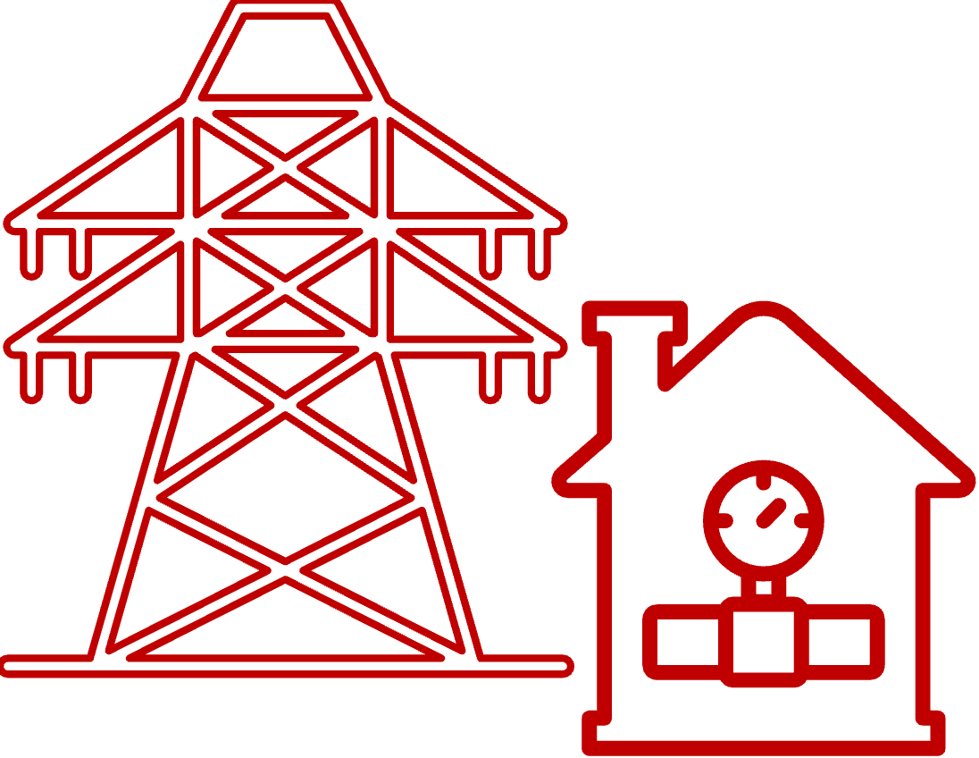


Use Cases – Proven Platform
Equipment location
Sound level
Air humidity
Air temperature
Ambient Light
CO2-level
Distance
Pressure
Accelerometer
Movement
Water temp
Water depth
Night light, guidance
On/Off wall plug
Fire Alarm
Presence detection (security, WiFi/BLE)
Level monitoring, Silos
Crop Freezing alert
Crop Anti-Freezing action
Mold Risk Detection, Crop
Energy Consumption, IMD
Water Consumption, IMD
Smart EV charging posts
License Plate recognition, garage
Passenger detection
People Counter, in-out
Desktop Occupancy
Detailed and distributed error detection power grid
Air Quality (hum, CO2, CO, PPM, hydrocarbons)
Theft detection (vibrations, ultrasonic)
Water quality farming (nutrition, PH, etc)
Thermostat control, radiators
Thermostat control, heating system
Cooling system monitoring, defrosting control
Power, measure consumption
Power, on/off
Parking Spot Usage
People Flow pedestrian tunnel
Bicycle Road, usage
Water Heating Temp
Wireless M-Bus Heating control
Aging in place
Smart homes
Smart windows
Water leakage
Door/Window, open/close
Light control
Digital doorbell with camera
Water valve on/off
Power cabinets
Waste Bin - Fill Level
Clean desks (Covid-19)
Bench/Pew usage
Energy distribution power grid
Street Light Control
Burglary alarm
Collect navigation data
Weather station
Asset Mgmt/Move Alert art
Storage Inventory
High School IoT Education
Classroom Occupancy Level
Ground Temp
Ground Temp Forecasting
LoRaWAN coverage
Satellite support, agriculture
Analysis and optimization of WiFi networks
Oversteering heating and ventilation
Measure ventilation and heat
Presence based lightning, heating, ventilation control
Automated Rounding
Operation Redundancy
Camera Control
Sailboat Racing Positioning
Water Leakage hidden in building constructions
Crane Wear Detection
Collecting engine data, shipping
Man-overboard detection & positioning
Accident detection, person (fall)
Personal Safety Alarm
School Restaurant Visitors
School Restaurant Queue Length
Airport indoor asset tracking
…………………………..
SMART BUILDING
SMART CITY
SMART HOME
SMART UTILITIES
SMART AGRICULTURE
SMART SOCIETY

